Slide 1



Elena Dries’ DATA ANALYTICS PORTFOLIO
elena@dries.info
www.ElenaDries.com

Slide 2









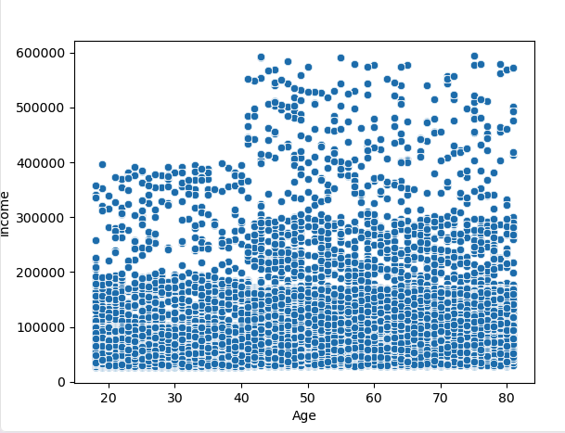
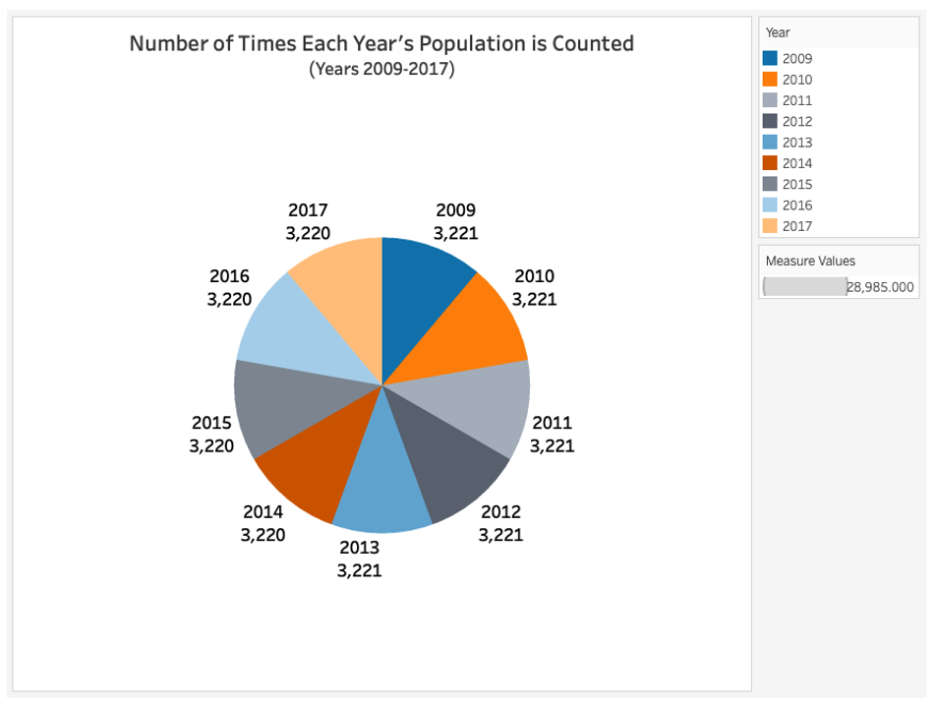
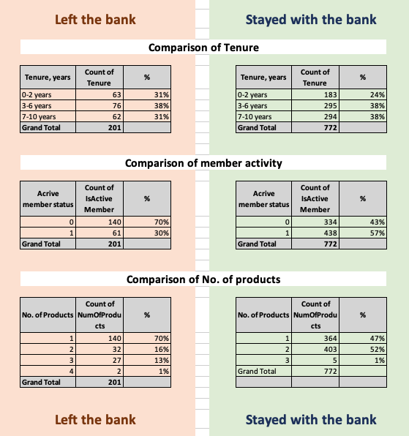
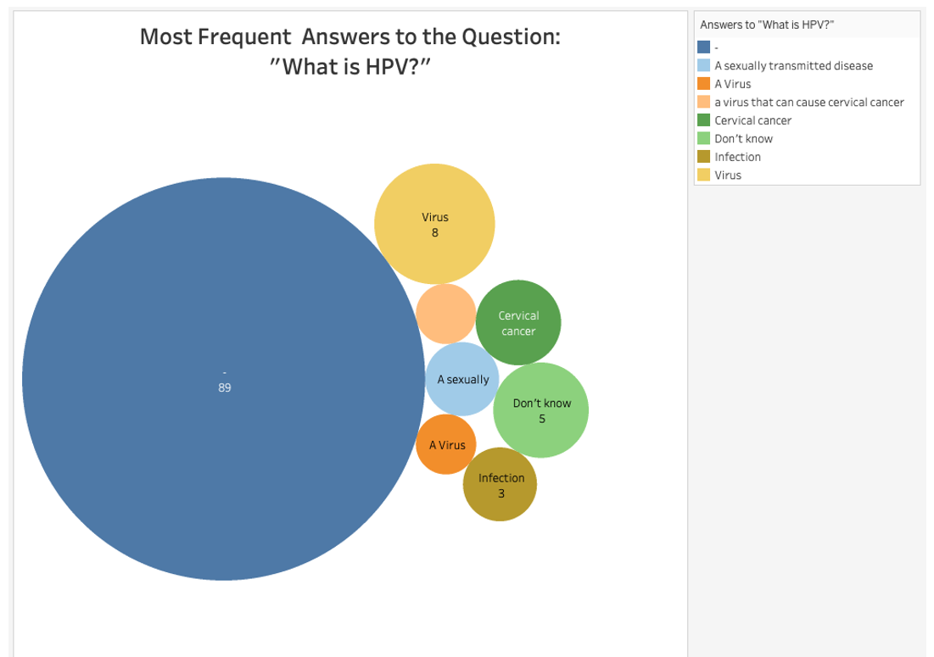
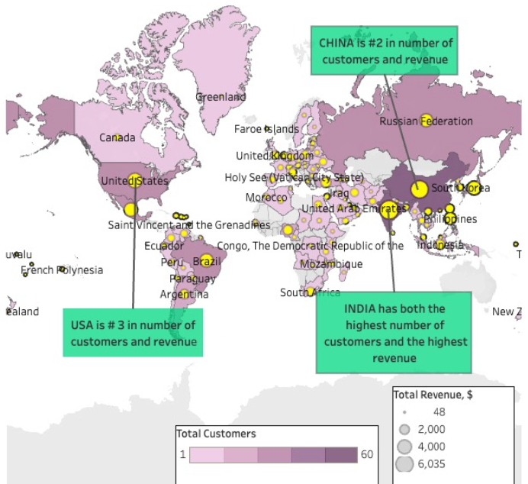
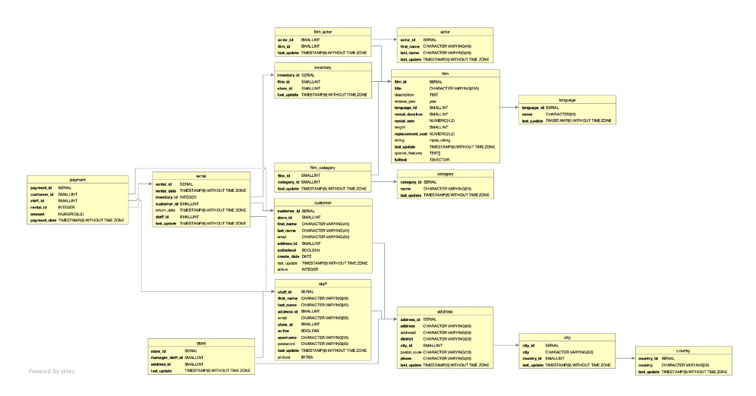
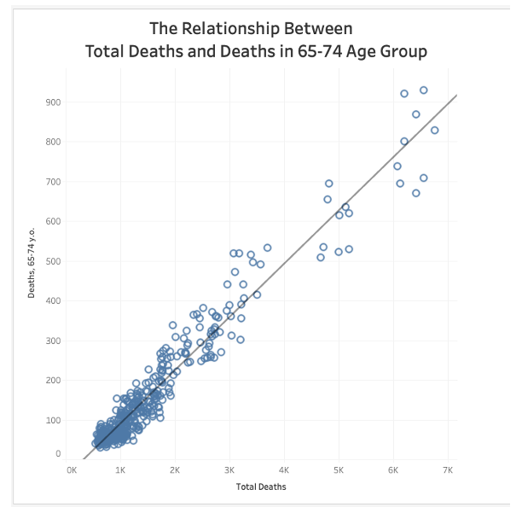
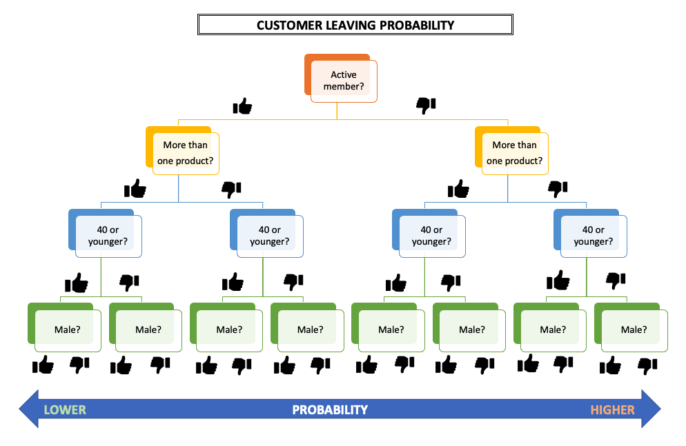
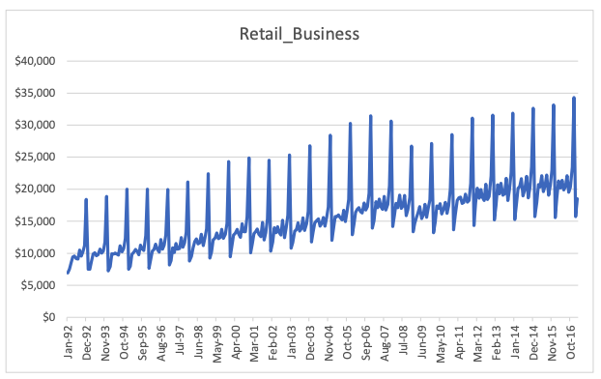
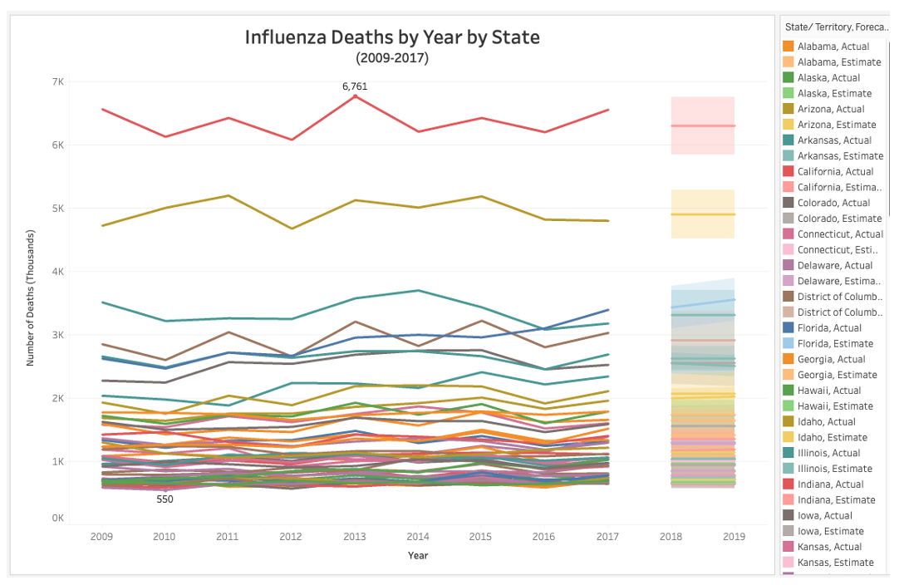
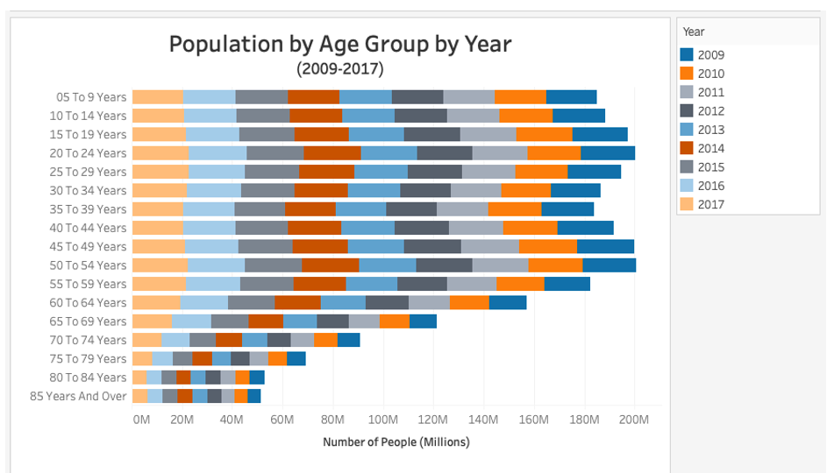
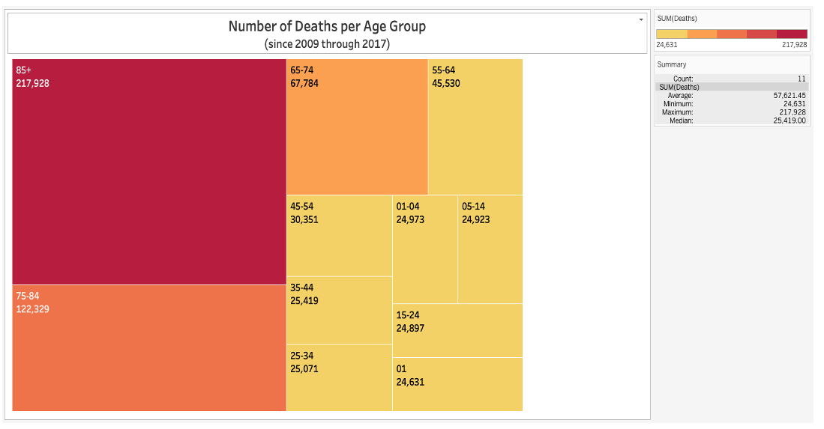
Slide Title
Tech Stack
Analytics

Slide 3




Project list
Preparing for Influenza Season
Rockbuster’s Top Performers
Instacart Grocery Basket Analysis
TBD

Slide 4

Preparing for Influenza Season
1.

Slide 5
Preparing for influenza season Project overview
Project Goals
Tools/Techniques
Data
Determine how much additional temporary staff to provide to adequately treat patients during flu season in the US.
Distribute the staff across different states.
Excel
Translating business requirements
Data cleaning/integration/ transformation
Statistical hypothesis testing
Visual analysis
Forecasting
Storytelling in Tableau
Influenza deaths by geography, time, age, and gender (Source: CDC) https://coach-courses-us.s3.amazonaws.com/public/courses/da_program/CDC_Influenza_Deaths_edited.xlsx
Population data by geography (Source: US Census Bureau) https://coach-courses-us.s3.amazonaws.com/public/courses/data-immersion/A1-A2_Influenza_Project/Census_Population_transformed_202101.csv
Influenza visits data set (Source: CDC (Fluview)) https://images.careerfoundry.com/public/courses/data-immersion/A1-A2_Influenza_Project/CDC_Influenza_Visits.xlsx

Slide 6
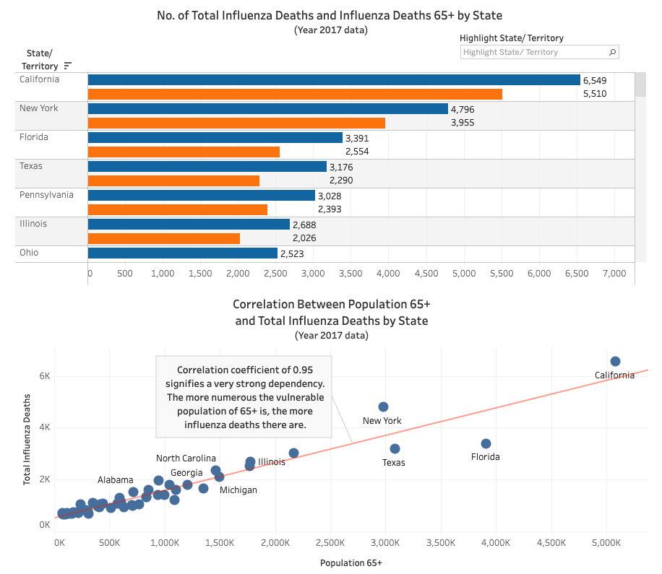
Preparing for influenza season Charts / interim points
Interim Points
Flu deaths are largely driven by the number of vulnerable population of 65+
The larger the vulnerable population, the greater the need for additional staff

Slide 7
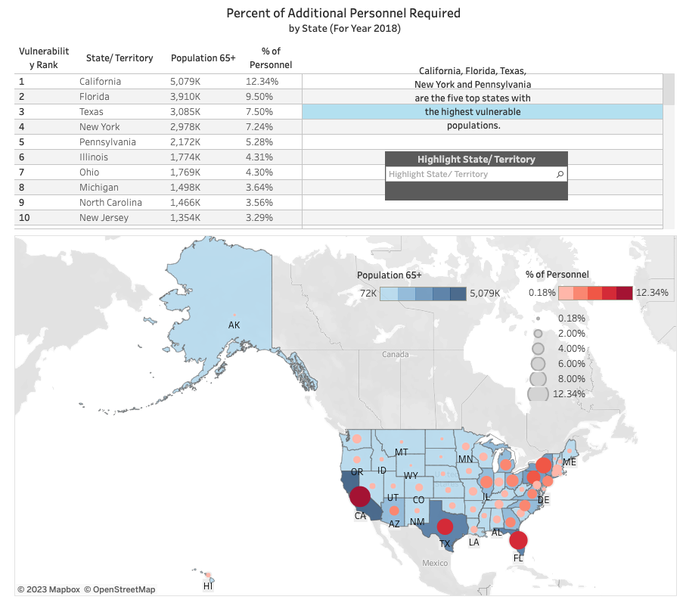
Preparing for influenza season results and deliverables
Results
Deliverables
YouTube Video Presentation:
https://youtu.be/I6eAgzEQmwg
Tableau Presentation (with interactive charts):
https://public.tableau.com/app/profile/elena.dries/viz/2_9_FinalProjectbyED/InfluenzaAdditionalPersonnelSupport?publish=yes
CONCLUSION
California, Florida, Texas, New York, Pennsylvania need the most additional medial personnel during the upcoming influenza season in the US.

Slide 8

Rockbuster’s top performers
2.

Slide 9
Rockbuster’s top performers Project overview
Project Goals
Tools/Techniques
Data
Where are Rockbuster’s customers based?
How different are the sales in different countries?
Who are the top 5 customers for recognition?
Relational databases
SQL
Filtering, cleaning, summarizing
Joining tables
Subqueries
Common table expressions
Database backup file (.zip):
https://careerfoundry.com/en/course/data-immersion/exercise/intro-to-relational-databases#relational-database-management-systems:~:text=download%20the%20database%20backup%20file%20(.zip)

Slide 10
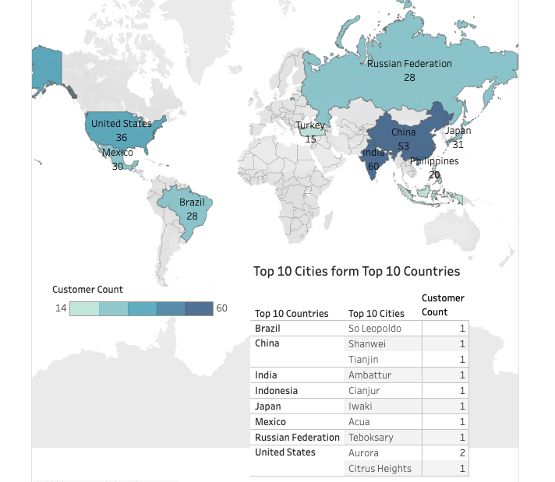
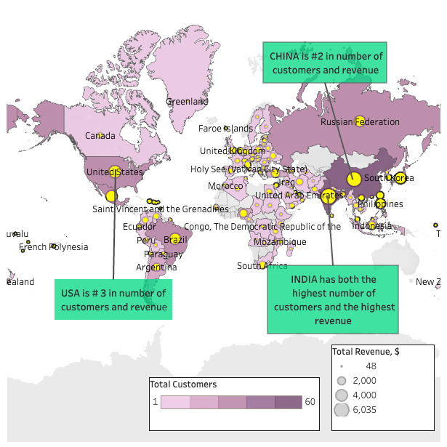
Rockbuster’s top performers Charts / interim points
Here is the list of the top 10 cities from the top 10 countries by the number of customers
Interim Points
India, China and the USA are leading in the geographical distribution of customers and generated revenues

Slide 11

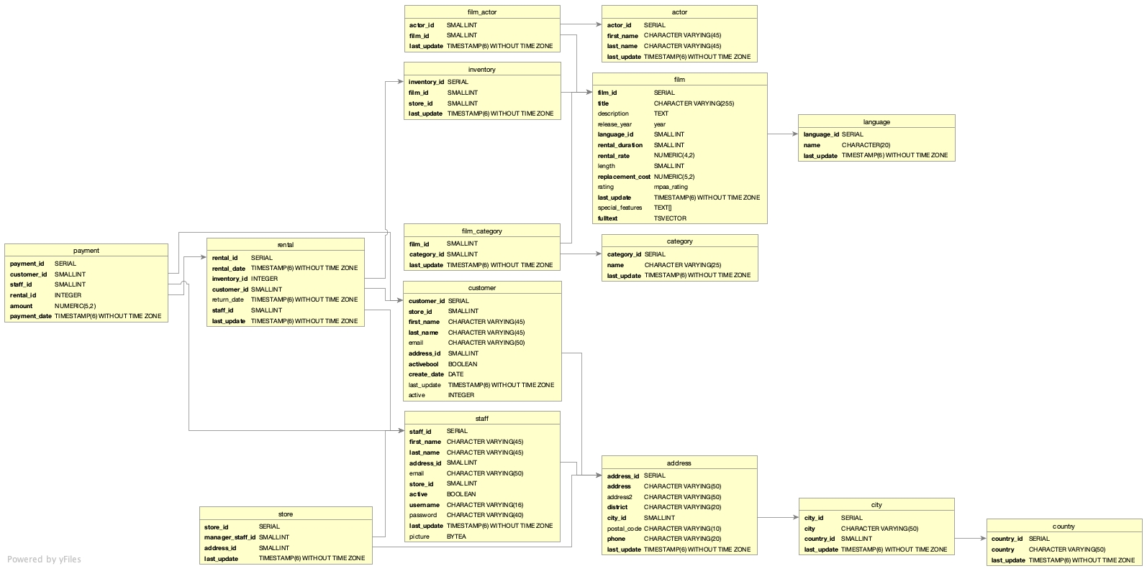
Rockbuster’s top performers results and deliverables
Results
Customer ID | Customer First Name | Customer Last Name | Country | City | Total Amount Paid, $
225 | Arlene | Harvey | India | Ambattur | $111.76
424 | Kyle | Spurlock | China | Shanwei | $109.71
240 | Marlene | Welch | Japan | Iwaki | $106.77
486 | Glen | Talbert | Mexico | Acua | $100.77
537 | Clinton | Buford | United States | Aurora | $98.76
Entity Relationship Diagram (ERD):
CONCLUSION
Here are the top 5 customers in the top 10 cities, who paid the highest total amounts to Rockbuster.
Deliverables
GitHub Repository:
https://github.com/Elena3s/RockbustersTopPerformers
Tableau Presentation (with interactive charts):
https://public.tableau.com/app/profile/elena.dries/viz/3_10byElenaDries/Story1?publish=yes

Slide 12
instacart grocery basket analysis
3.

Slide 13
Instacart grocery basket analysis Project overview
Project Goals
Tools/Techniques
Data
The Instacart Online Grocery Shopping Dataset 2017, accessed in December 2022:
https://www.instacart.com/datasets/grocery-shopping-2017
Orders and Products (.zip):
https://s3.amazonaws.com/coach-courses-us/public/courses/data-immersion/A4/A4_Data_Assets/4.3_orders_products.zip
Departments (.zip):
https://s3.amazonaws.com/coach-courses-us/public/courses/data-immersion/A4/A4_Data_Assets/4.4_departments.zip
Customers (.zip):
https://s3.amazonaws.com/coach-courses-us/public/courses/data-immersion/A4/A4_Data_Assets/customers.zip
Data Dictionary:
https://gist.github.com/jeremystan/c3b39d947d9b88b3ccff3147dbcf6c6b
Uncover sales patterns
Derive insights on better market segmentation
Python
Pandas
Data wrangling, merging
Deriving variables
Grouping and aggregating data
Reporting in Excel
Population flows

Slide 14
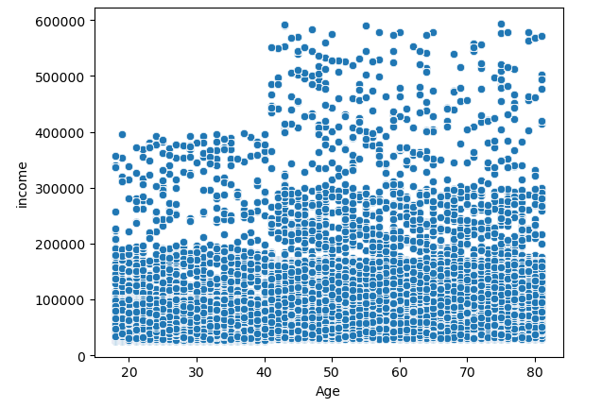
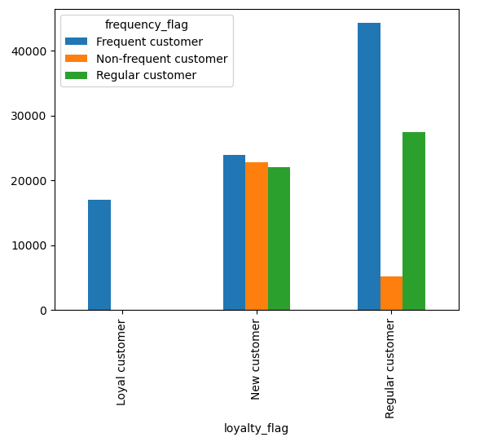
Instacart grocery basket analysis charts / interim points
No. of users
At the age of 40 many Instacart customers transition from <200K to <300K income. The income ceiling also jumps up from 400K to 600K at the same age line of 40.
The most loyal customers (with over 40 orders) are also frequent customers ( <= 10 days between orders)
The regular customers in terms of loyalty (from 11 to 40 orders) show a prevalence of being frequent in their purchases, while only a small portion of them have more than 20 days between their orders.
The new customers are evenly distributed among the frequency categories.

Slide 15
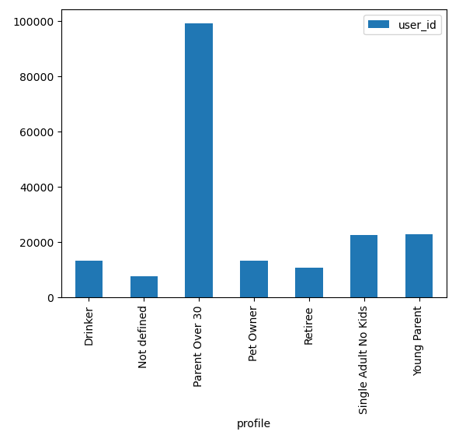
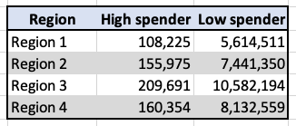
Instacart grocery basket analysis results and deliverables
Results
No. of users
No. of users
Region 3 has the most customers and almost doubles both High and Low spenders when compared to Region 1. Regions 2 and 4 are hanging somewhere in between.
Deliverables
Profile
GitHub Repository:
https://github.com/Elena3s/InstacartGroceryBasketAnalysis
The profile category "Parent over 30" (and below 65, with dependents) is by far the most numerous one. (NB: Some profiles may overlap.)

Slide 16


US residential real estate
4.

Slide 17
Us residential real estate analysis Project overview
Project Goals
Tools/Techniques
Data
Investigate how/if the property size affects its sq.ft. price (2016-2023)
Investigate the relationship between property size and how fast it closes (2016-2023)
Discover the hottest residential markets as of 2022
Python
Pandas/seaborn/
matplotlib/sklearn
Linear regression
Elbow technique
k-means clustering
Time series
Publicly available source on realtor.com:
https://www.realtor.com/
research/data/
(downloaded in February 2023, updated on a monthly basis)

Slide 18
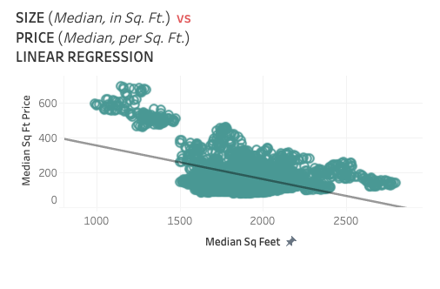
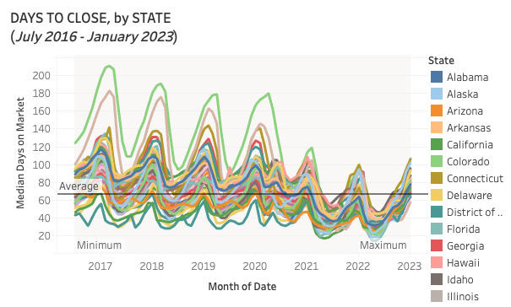
Us residential real estate analysis charts / interim points
The national average number of days to close between 2016-2023 is at 66.8 days. The number one state with the shortest average time to sell is the District of Columbia - at 40.3. The slowest' is Vermont - at 118.7 days.
The property size contributes about 48% to its sq.ft. price - medium strength dependency, which means that even though it plays a considerable role in defining the square foot price we cannot fully rely on the property size in order to explain the behavior of its square foot price.

Slide 19
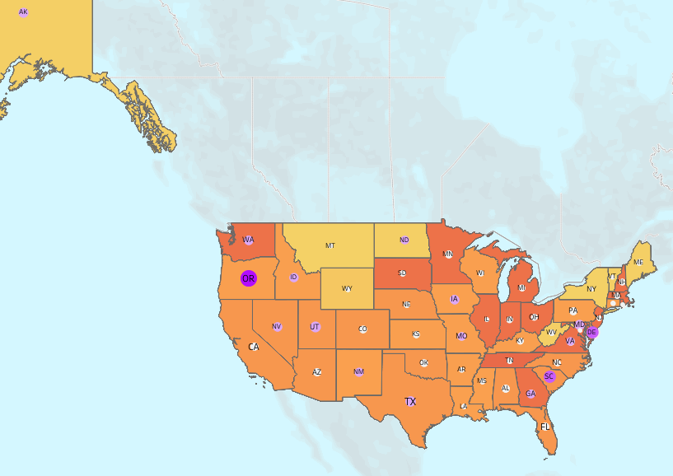
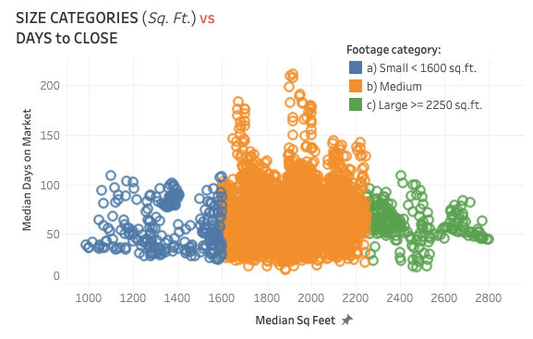
Us residential real estate analysis results and deliverables
Results
In 2022 Oregon leads the market in the share of properties with increased prices: 19.52%, followed by Delaware and South Carolina: 10.54% and 10.87% respectively.
The quickest states to sell their homes in 2022 (in average days):
State | Days
Rhode Island | 51
Maryland | 57
Ohio | 58
Indiana | 59
Virginia | 59
Small and large properties, on average, have very little chance to get stuck on the market for longer than 110 days.
Medium-sized properties have a risk of hanging there for much longer - up to 210 days, even though the majority of them do sell in under 110 days.
Deliverables
GitHub Repository:
https://github.com/Elena3s/US-Residential-RE-Analysis
Tableau Presentation (with interactive charts):
https://public.tableau.com/app/profile/elena.dries/viz/USRealEstateMarket_16800293963450/USREMarket?publish=yes

Slide 20



Contact info
elena@dries.info
www.ElenaDries.com
Social media

